Slide 1


Bash Scripting
The Handsome Seastars

Slide 2
Bash Scripting
The Handsome Seastars

Slide 3
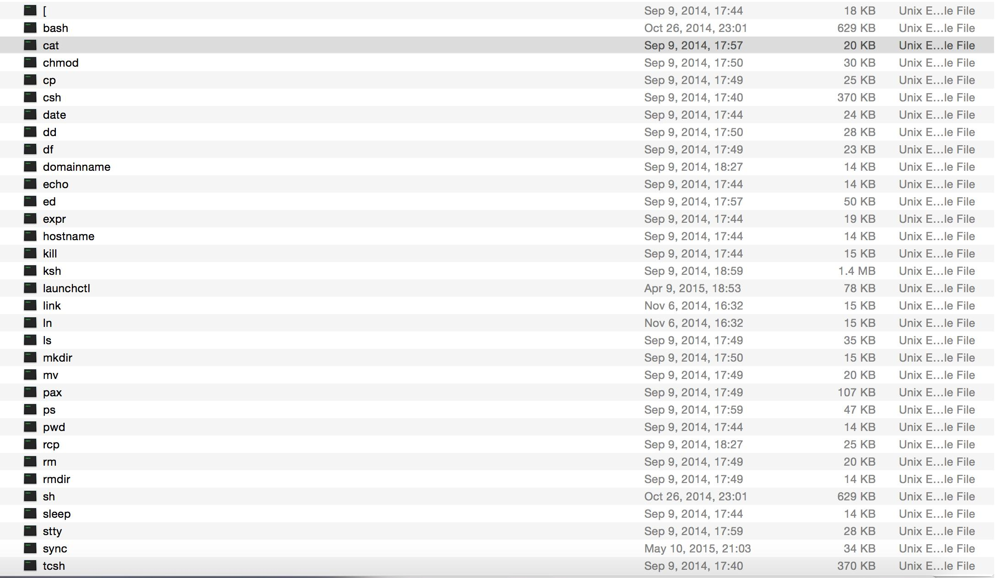
Know your BASH commands
SHELL HISTORY
Here are some of the commands you’ll be using in the Bourne-Again Shell on Unix and BSD.
Bash was made to succeed the Bourne shell, which is why it’s called “Bourne-Again.”
But shells like zsh (z-shell), csh (c-shell), and tcsh (extended c-shell) are also included in many modern systems and improve upon Bash in various, specialized aspects.
Zsh blends many features of Bash, Csh, and Tcsh to extend Bash w/ usability and applicability enhancements like autocomplete, arrays, command history for all shells, and more.
Csh/tcsh was especially differentiated from Bash in the 1980s.
It featured a new style of scripting language, more similar to C, and considered less-awkward to use, especially to programmers of the era already competent in C.
However - all these shells are based on sh, the original Bourne shell for Unix.

Slide 4
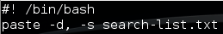
Search-list.txt commands
Start by creating a list of words, named search-list.txt
Next vim listMaker
Adding the following script, then giving permission to run with chmod 755 listMaker
Finally, running it outputs all the words as a single line separated by commas with ./listMaker

Slide 5
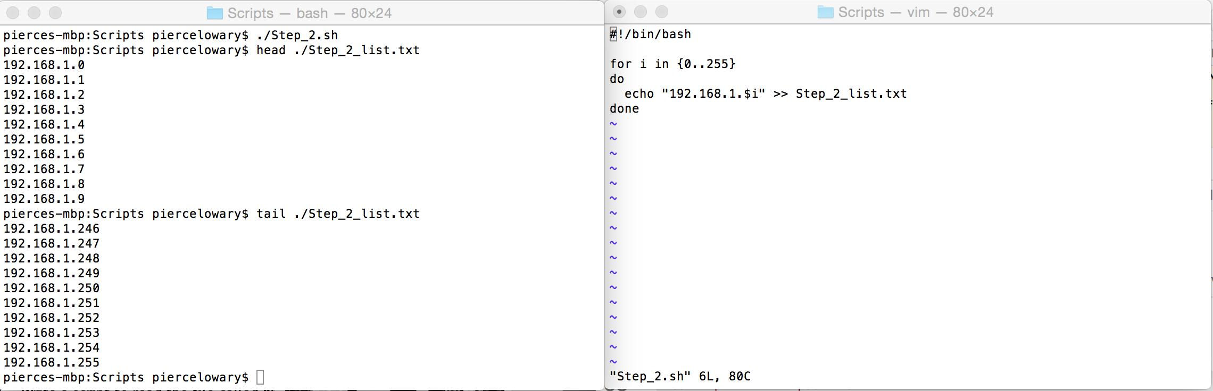
IP Address Printing

Slide 6
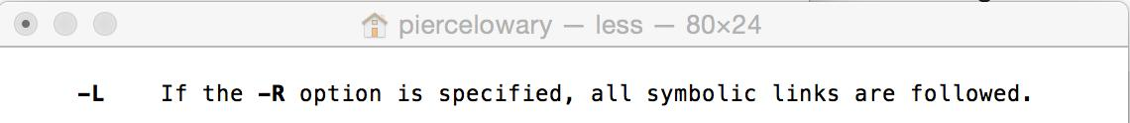
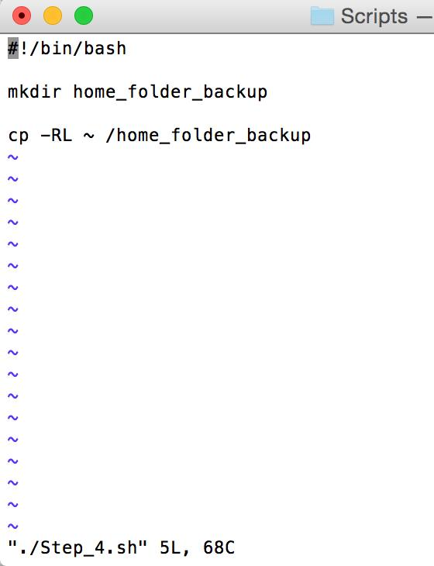
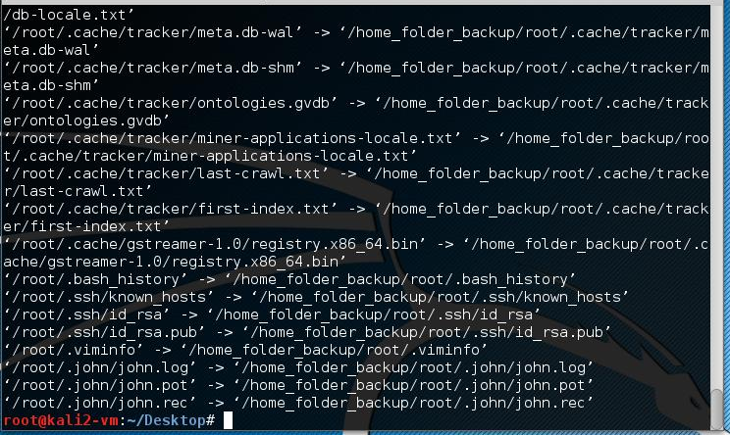
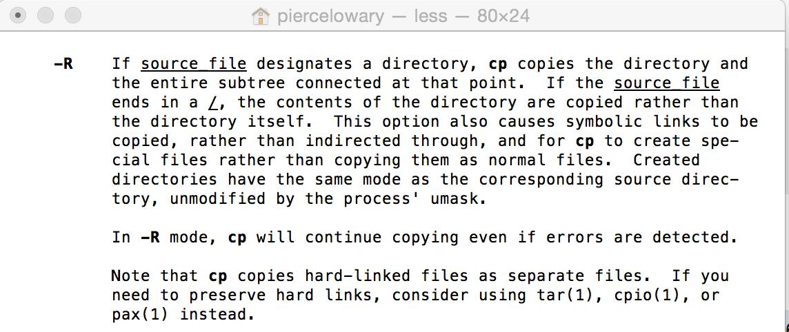
Backup Home Folder

Slide 7
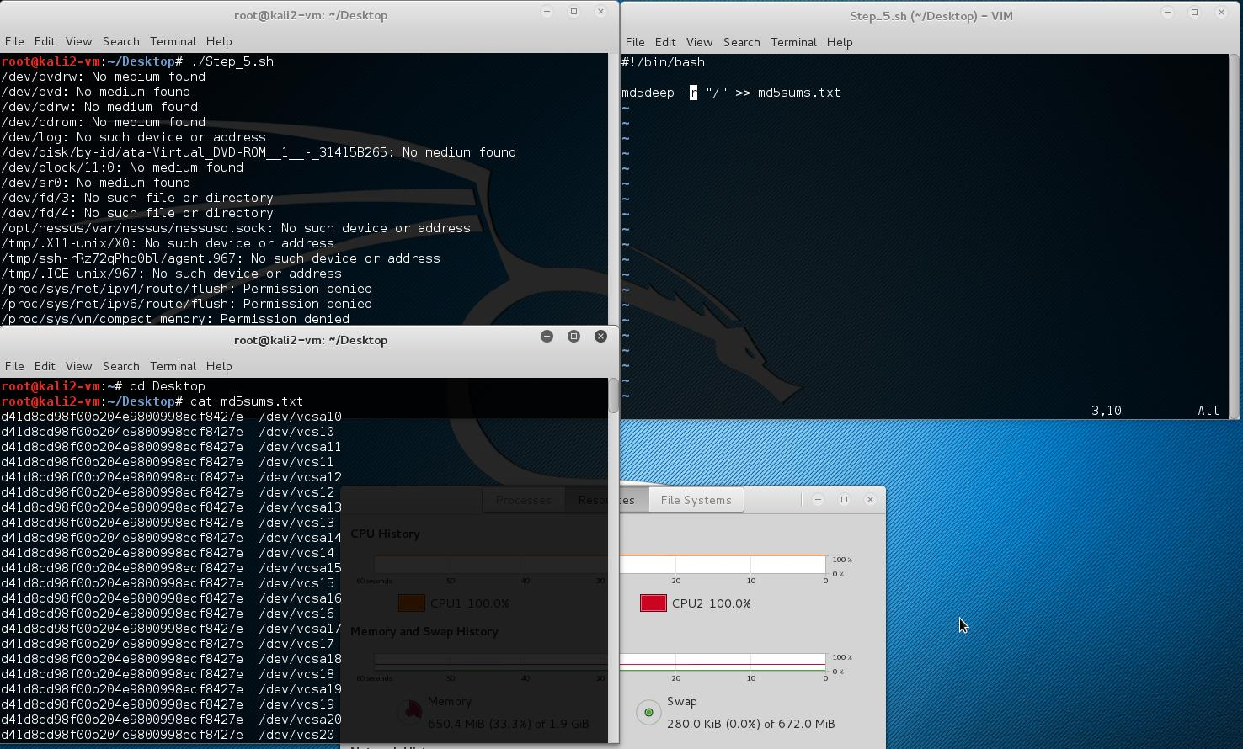
MD5 hash for all files
The MD5 hashes of a batch of files can be used to verify that the files on your machine are the same as the ones from the source, and haven’t been tampered with in transit.
However, MD5 is no longer secure.
Use SHA-256, 512, or 1024 instead.

Slide 8
list-1.txt ‘and’s
tr ‘ ’ ‘\n’ < (file location) | grep -c ‘\<and\>’ | wc -l

Slide 9
Write list-1.txt in upper case
$ tr ‘[:lower:]’ ‘[:upper:]’ < input.txt > output.txt
$ cat output.txt

Slide 10
Downloading: curl v. wget
Two major Linux command-line utilities exclusively for downloading + working with web content
Powerful
Slight, but major differences between them

Slide 11
curl
Since ‘96
Use for more features
No recursive logic or HTML parsing
One page at a time
More protocols
(S)FTP, Gopher, HTTP(S), Telnet, POP/IMAP, SMB, LDAP(S)...
Many, many more platforms
***More SSL libs and authentication support
Better support for HTTP
Multipart downloading
Form data sending
HTTP2
***Gzip, inflate Content-Encoding + automatic decompression
Important for this lab
Transfer-Encoded HTTP

Slide 12
wget
Since ‘95
CLI only
***Recursive -- major use case
Easy, quick downloading -- run and done
GNU licensed (CURL is MIT-licensed)
GnuTLS only/OpenSSL only
Basic auth only
Data transfer recovery
No proxy (SOCKS) support

Slide 13
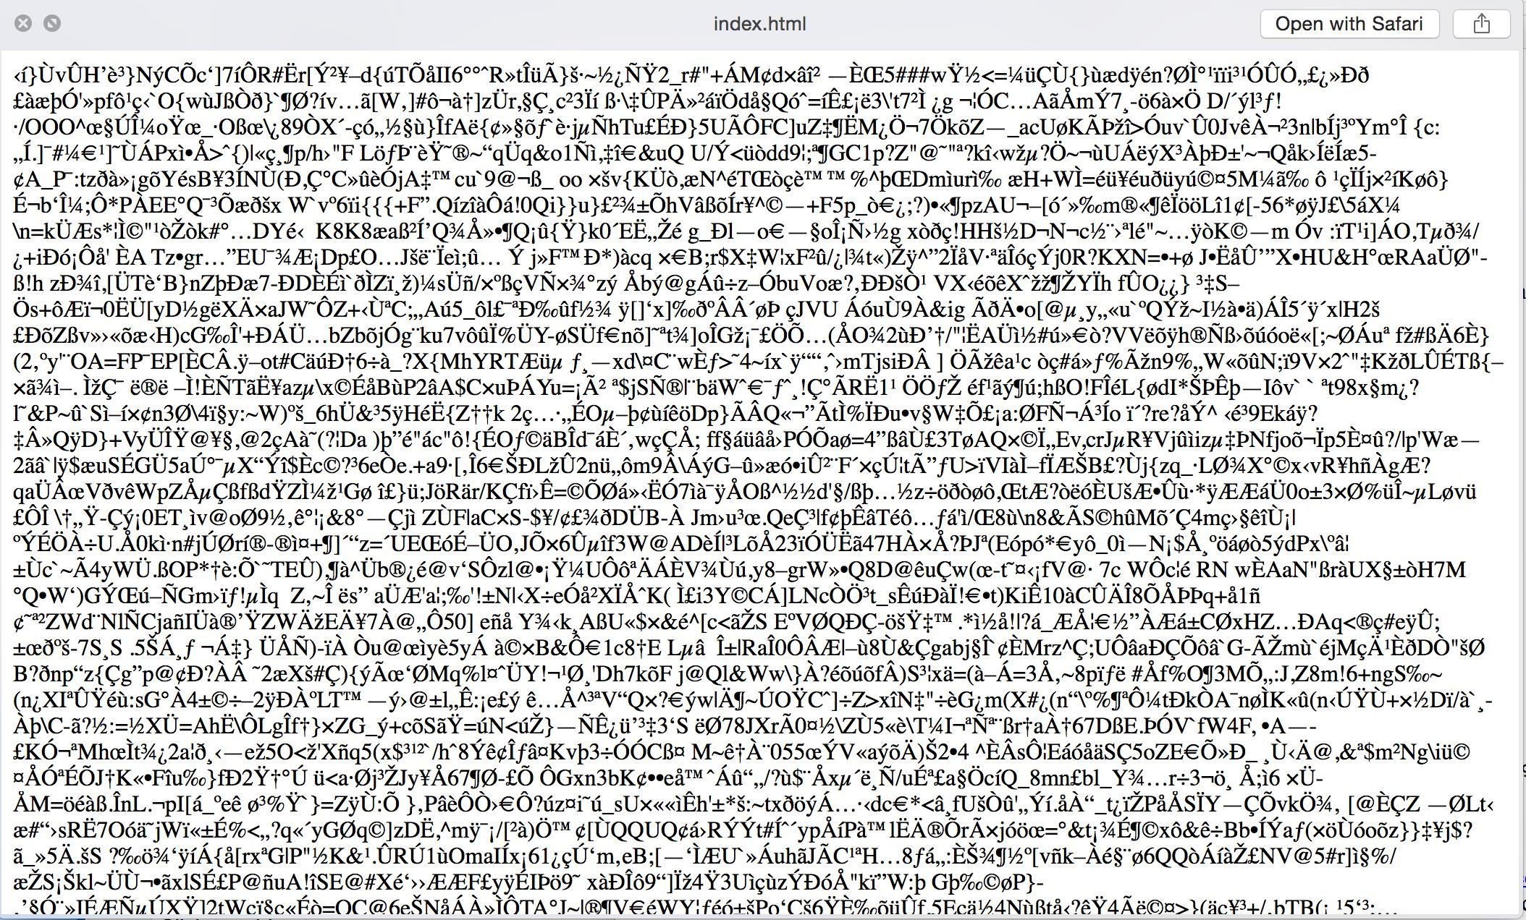
Downloading offensivesecurity.com
Difficulties w/ downloading the webpage
Text would be garbled like this:

Slide 14
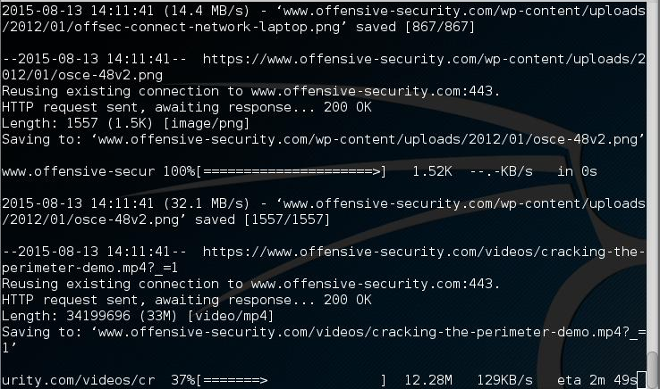
Downloading offensivesecurity.com
Upgrading the OpenSSL stack with dist-upgrade fixed the issue
wget -x -r https://www.offensive-security.com -l inf --retry-connrefused --secure-protocol=auto

Slide 15
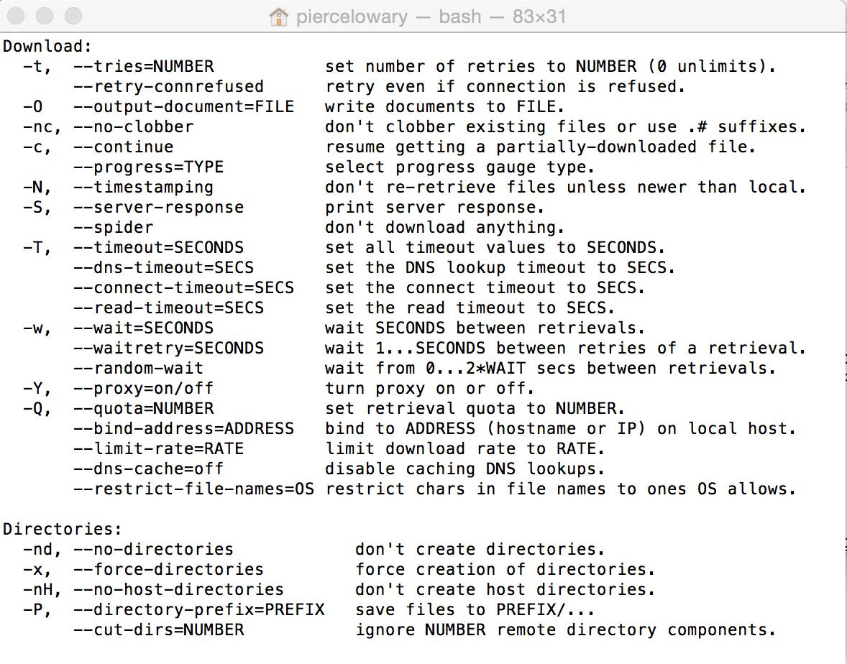
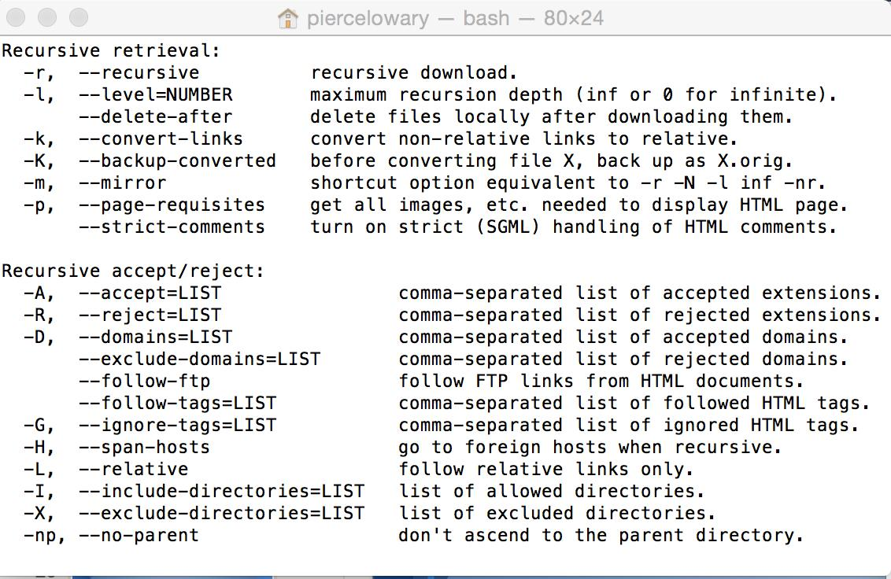
Wget command-line descriptors
wget -x -r https://www.offensive-security.com -l inf --retry-connrefused --secure-protocol=auto

Slide 16
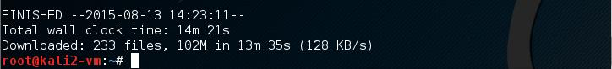
And we’re done!
Download successful
14 minutes 21 seconds
Infinite recursion → all files
233 files
102 MB

Slide 17
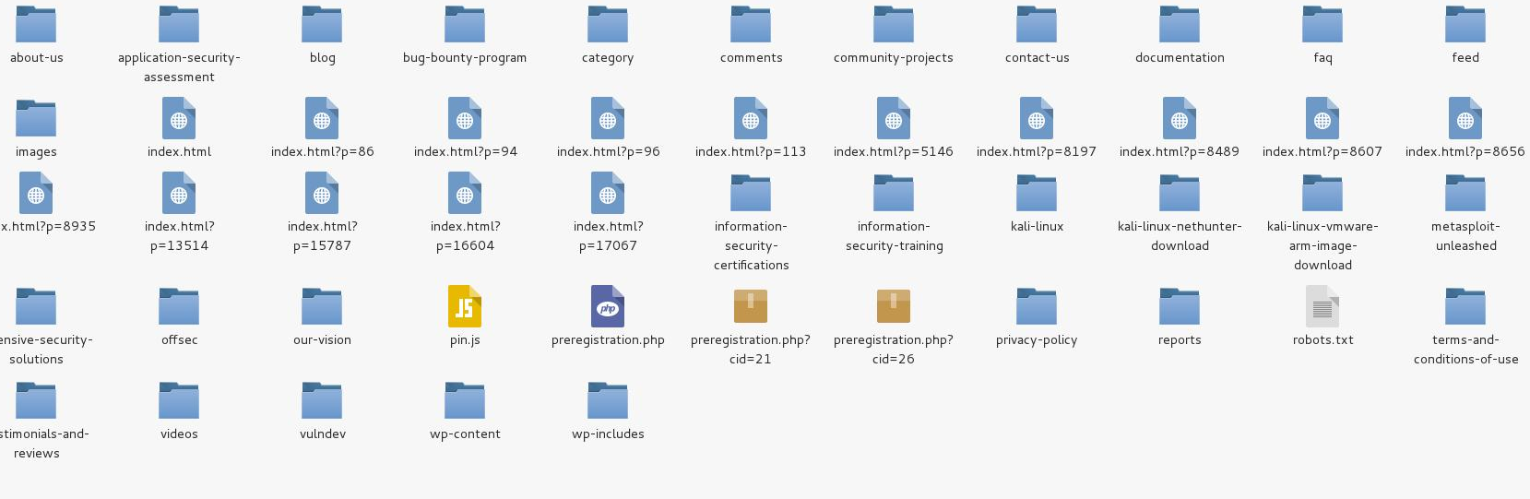

Slide 18
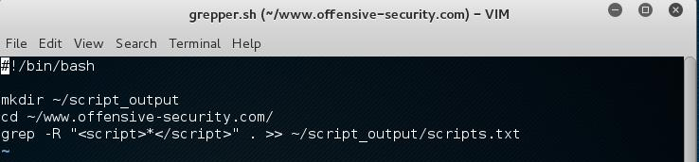
grep to find <script>
Or:
find . -type f -exec grep -l “<script>*</script> {} +
Find is used to find files matching a certain name or certain contents.

Slide 19
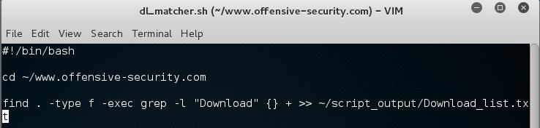
Files with ‘Download’

Slide 20
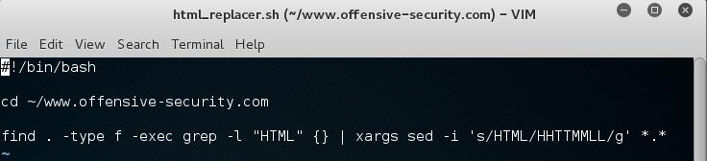
HTML → HHTTMMLL
Same find command as before.
Pipe file names containing “HTML” to xargs and sed for processing.

Slide 21
More on xargs and sed
xargs, here, assists in passing the entire previous command to sed as an argument.
sed
stream editor
Works with input streams → basically, lines of text output by something else
Piped
Designated
Advanced filtering capabilities make it especially powerful
Modifies input based on given commands
-i edits files in place (as they are).
s/ substitutes replacement expression “HHTTMMLL” for first occurrence of “HTML”.
/g tells sed to make the substitution for all matches.

Slide 22
More on sed
Developed from ‘73 to ‘74 for Ver. 7 Unix
Line-oriented; 25 commands + all regex
Extremely fast minised variant
Lee E. McMahon of Bell Labs
Based on the older ed, qed
Inspired functionality of awk and perl scripting languages

Slide 23
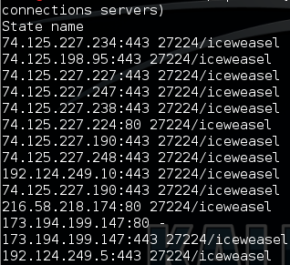
Netstat for foreign addresses
netstat -ntp | awk ‘{print $(NF-2),$NF}’

Slide 24
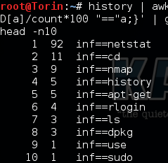
Most used commands
history | awk ‘{CMD[$2]++;}END { for (a in CMD)print CMD[a] “ “ CMD[a]/count*100 “==” a;}’ | grep -v “./” | column -c3 -s “ “ -t | sort -nr | nl | head -n10

Slide 25
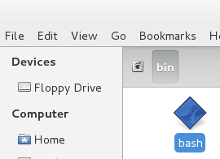
Bash Interpreter Location
#!bin/bash is where the interpreter is located
So opening Computer -> System Files -> Bin there is a file called “Bash”

Slide 26
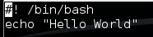
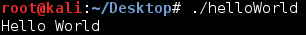
Display Hello World
Start with: vim helloWorld to create and edit the file
Then give everyone executable permission with: chmod 755 helloWorld
Finally execute with: ./helloWorld

Slide 27
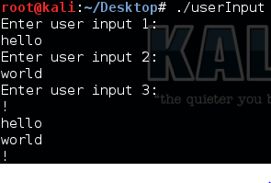
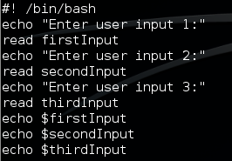
Get 3 User inputs and display
Starting with vim userInput edits the desired file to add the code below
Next assign executable permissions with chmod 755 userInput
And finally, execute with ./userInput
The program asks for our three inputs then prints them on 3 seperate lines

Slide 28
Clear shell history
Start with vim bashClearer
Next, add the code to clear the bash
Then, add executable permissions with chmod 755 bashClearer
Finally, execute with ./bashClearer

Slide 29
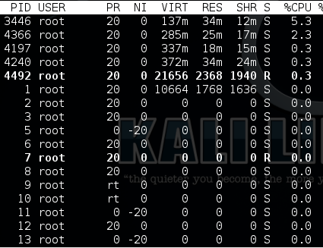

List Process by CPU Usage
Starting with vim processDisplay
The top command is like a build in task manager, so we can just write what is basically an alias for this command
Give is executable permissions with chmod 755 processDisplay
Run with ./processDisplay
Note: top is a similar utility that’s included on nearly
all modern Linux distributions.

Slide 30
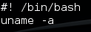
32 or 64 bit OS
Start with vim bitCount to start editing
The code: uname -a will display the operating system
Give executable permission with chmod 755 bitCount
Finally, run with ./bitCount
The 64 or 32 bit part is listed towards the end

Slide 31
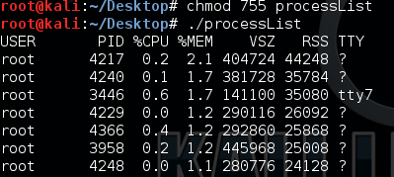

Process by memory usage
Start with vim processList
--sort sorts the output of ps aux and -rss shows --sort what to sort by, -rss is memory usage
Give executable permission with chmod 755 processList
Finally, run with ./processList to display the list

Slide 32
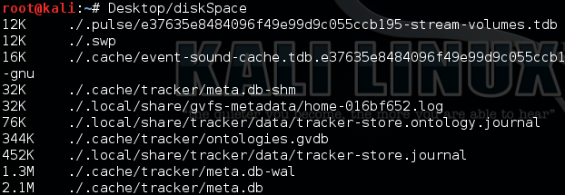
Largest Disk Space
Start with vim diskSpace
After adding the code, give executable permission with chmod 755 diskSpace
The command will only search the current directory, so moving back to the root directory and using: Desktop/diskSpace shows the disk size of files on the root directory

Slide 33
Excel-list2.txt display data
download file, convert to unitext, put on google drive, download on VM, go to terminal, type cd Desktop, then type vim (the filename you choose), if the filename has spaces then put quotation marks around the name, then voila it make magic.

Slide 34
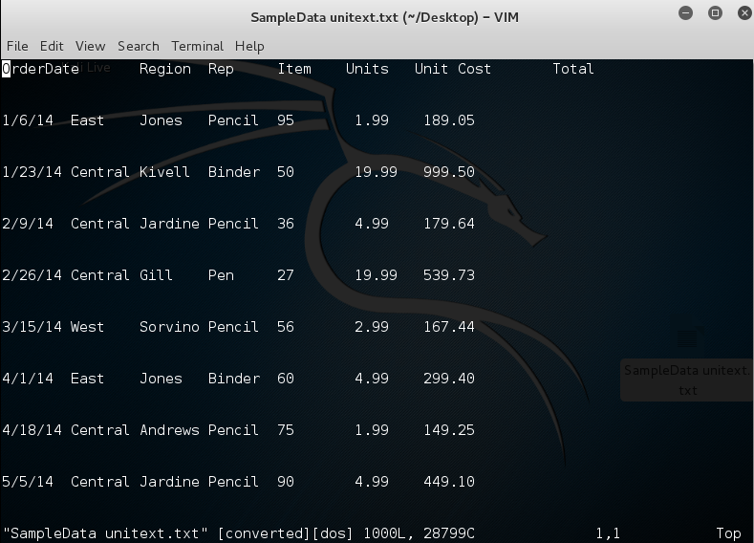
Cont.

Slide 35
Shell Commands
-A after
-B before
-E extend
-M number of instances

Slide 36
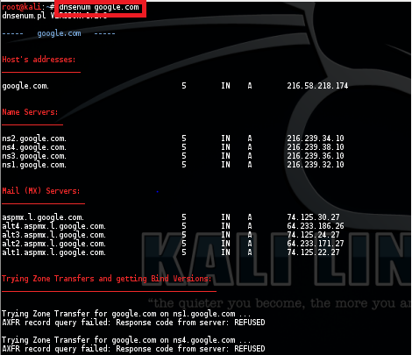
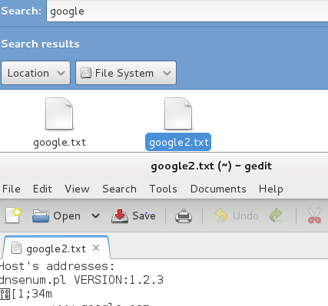
dnsenum on google.com

Slide 37
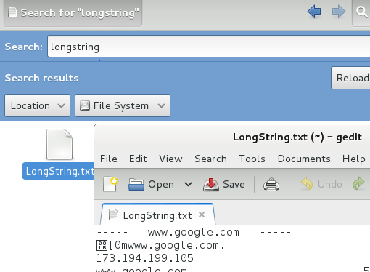
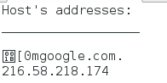
DNSenum Host’s Address

Slide 38
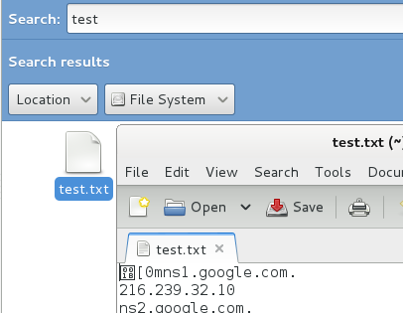
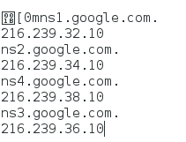
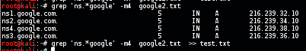
DNSenum Name Servers

Slide 39
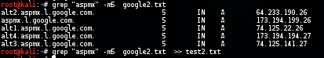
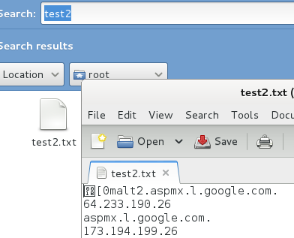
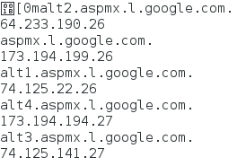
DNSEnum Mail(MX) Servers

Slide 40
Sources
stackoverflow.com

